Slide 1

The Higher Education Academy Fellowship Scheme: UWA Academy Fellowship Scheme
Dr Rosalind Duhs, Advance HE & University College London (UCL)

Slide 2
Outline
Images – UCL
Quotes – UWA AFS
What is the Higher Education Academy Fellowship Scheme?
What is the Professional Standards Framework?
What’s the Scheme for?
The UWA Academy Fellowship Scheme – 50+ new Fellowship applications

Slide 3

What is the Higher Education Academy Fellowship Scheme?
A popular globally-respected series of awards - ‘Fellowships’
Fellowships recognise high quality teaching and support of learning in tertiary education
The opportunity to reflect on teaching via the application process can only serve to enhance my teaching and support of learning... It also made me think more about innovative and inspirational teaching practices. (UWA AFS participant 2019)

Slide 4
Global Fellowships
Over 123,000 Fellows across the world, 6,100+ outside the UK
90+ different countries
Rapid international growth – nearly 1,000 (965) extra Fellows since 1 May.
Australia: greatest number of Fellows outside the UK, highest number of Principal Fellows
Figures for 22 October 2019

Slide 5
Australian/NZ Advance HE 27 Members (October 2019)
Australian Catholic University | Australia | Int – Access | No
Australian Institute of Business | Australia | Int – Access | No
Central Queensland University | Australia | Int – Access | No
Charles Sturt University | Australia | Int – Access | No
Curtin University | Australia | Int – Strategic | No
Deakin University | Australia | Int – Strategic | No
Griffith University | Australia | Int – Strategic | Yes
La Trobe University | Australia | Int – Access | No
Macquarie University | Australia | Int – Access | No
Monash University | Australia | Int – Strategic | No
Murdoch University | Australia | Int – Strategic | Yes
Navitas | Australia | Int – Access | No
Queensland University of Technology | Australia | Int – Global | Yes
RMIT University | Australia | Int – Access | No
The Australian National University | Australia | Int – Global | Yes
The University of Adelaide | Australia | Int – Access | No
The University of Queensland | Australia | Int – Strategic | Yes
TOP Education Institute | Australia | Int – Strategic | No
University of New South Wales | Australia | Int – Strategic | No
University of Sydney | Australia | Int – Strategic | Yes
University of Tasmania | Australia | Int – Strategic | Yes
University of the Sunshine Coast | Australia | Int – Strategic | Yes
University of Western Australia | Australia | Int – Strategic | Yes
University of Wollongong | Australia | Int – Access | No
Western Sydney University | Australia | Int – Access | No
Auckland University of Technology | New Zealand | Int – Strategic | Yes
Massey University | New Zealand | Int – Strategic | Yes

Slide 6
Working with Australasia
Advance HE has developed specific networks for Australasia:
Australasian Strategic Advisory Board – A strategic board - DVC Education (or equivalent) representatives, to influence and steer Advance HE’s work in the region.
Australasian Programme Managers’ Network for programme leads (accredited or planning accreditation)

Slide 7
At UWA 50+ applied! Why this popularity?
The Professional Standards Framework
for teaching and supporting learning in higher education
It’s about you.
Individual impact → institutional impact →
wider impact

Slide 8

What is the Professional Standards Framework?
What’s on the tin?
A general description of the main dimensions of the roles of teaching and supporting learning in higher education
Practitioner-focused – your practice
Comprehensive framework to recognise and benchmark teaching and learning support in higher education

Slide 9

What’s the Framework for?
Promote professionalism in teaching and learning support in higher education →
Enhance the learning experience of students

Slide 10

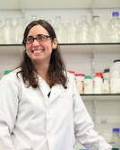
UWA Survey data October 2019
‘… the reflective nature of the application allowed me to really think about why I do what I do in the teaching space. We rarely allow ourselves these times to just think, and so I see this as perhaps the best outcome of the process.’
This process has affirmed my role as an effective and impactful leader,

Slide 11

Expand your teaching and learning horizons through …

Slide 12

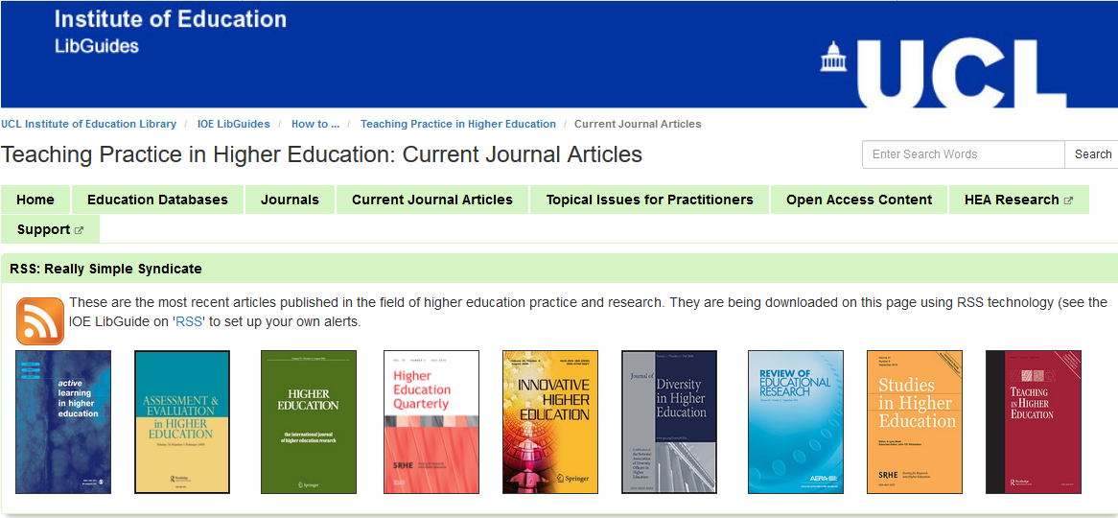

Your PSF
Exchange of practice
Learn with others
Literature
Write/talk about your
educational achievements

Slide 13
AFS participant perspective (SF)
‘The impact lies in the recognition/acknowledgement/self-acknowledgement of one's leadership in the T&L area. The process forced me to think about leadership, management, curriculum reform, change management and mentoring. I would not have seriously considered these, or my place in them, if I had not gone through this process. The process re-affirmed that I am a leader.’

Slide 14


Your perspectives on Fellowships
Please talk to the person/people next to you.
Any questions for the Panel?

Slide 15


